Slide 1
REMOTE
PHONEBOOK
By : Group 6
Github Link: https://github.com/Ayesh18/Remote_Phonebook
Mentored By: Sankar Banerjee

Slide 2
MEMBERS
Arpita
Sainath
Dileep
Vinaykumar
Ayeshkanta
Utkarsh

Slide 3
TIMELINE OF THE PROJECT
SRS Release
Coding and implementation
IT planning and testing
12.10.22
13.10.22
17.10.22
Designing
Tools Report
12.10.22
17.10.22

Slide 4
TABLE OF CONTENTS
01
02
INTRODUCTION
FLOWCHARTS
03
04
NON-FUNCTIONAL REQUIREMENTS
FUNCTIONS & CODE EXECUTION
05
06
CHALLENGES FACED
CONCLUSION

Slide 5
01
INTRODUCTION

Slide 6

WHAT IS REMOTE PHONEBOOK?
To establish a dial-up connection to a remote server, the host attempting to connect must have an entry in the remote phonebook.
Just like a regular telephone book, the remote phonebook contains entries that enable a remote dialer to specify a connection by name.
A phonebook entry contains all the necessary information that the device needs to establish a connection to the server, including the phone number to call,any user authentication information, and any other connection properties.

Slide 7
SYSTEM REQUIREMENT SPECIFICATIONS(SRS)
A remote phonebook setup to be established.
Each user access category has specified functionalities
After server is started, it listens to port 8028 for clients.
Contact deletion,contact addition
and group addition and remove
Connection between client and
the server is established.
Connection can be terminated
by a specific command by user.
Three user access categories based on authentication
Made different flowcharts to understand the outline of
problem statement

Slide 8
02
FLOWCHARTS

Slide 9
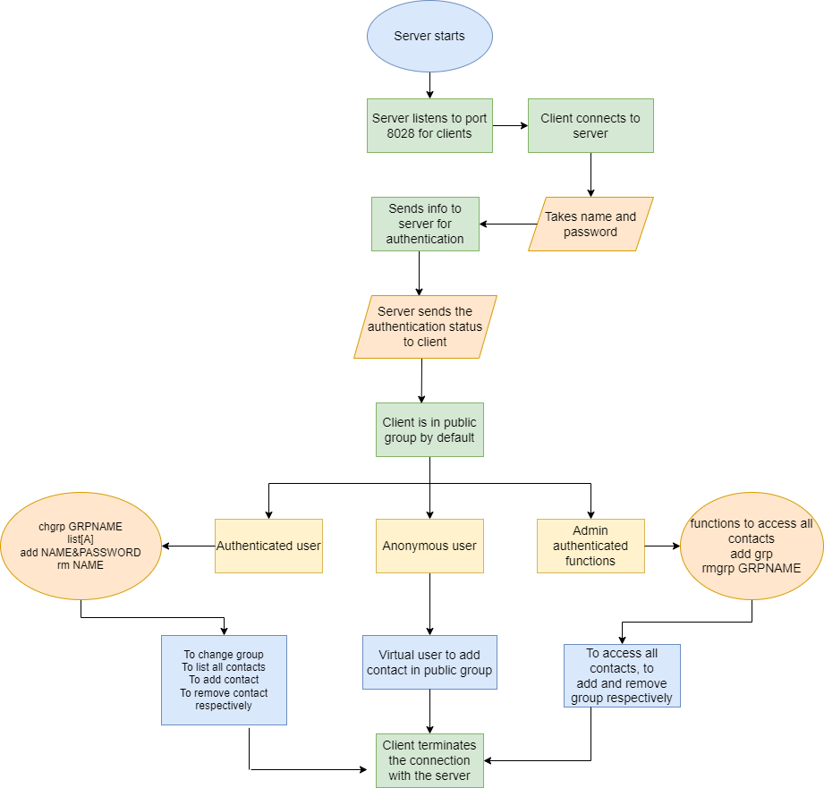
FLOWCHART FOR THE PROCESS

Slide 10
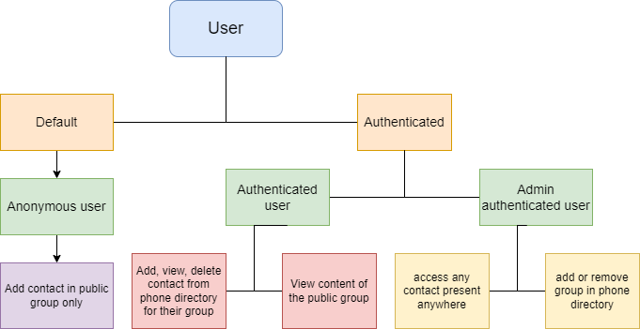
FLOWCHART FOR USERS

Slide 11
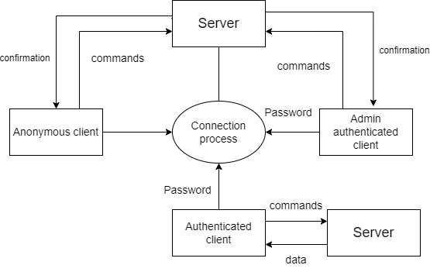
LOW LEVEL DIAGRAM(LLD)

Slide 12
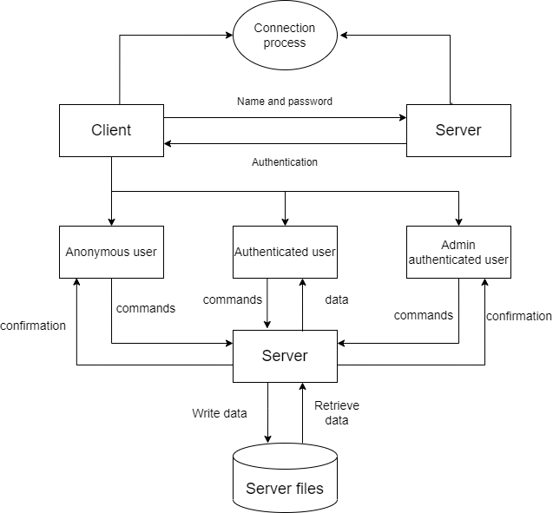
HIGH LEVEL DIAGRAM(HLD)

Slide 13
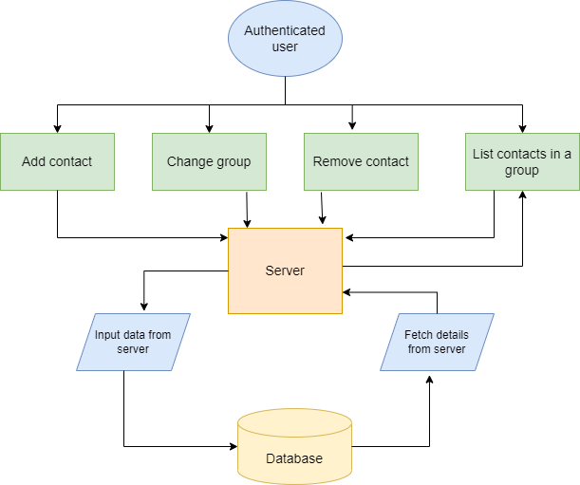
FUNCTIONS OF AUTHENTICATED USER

Slide 14
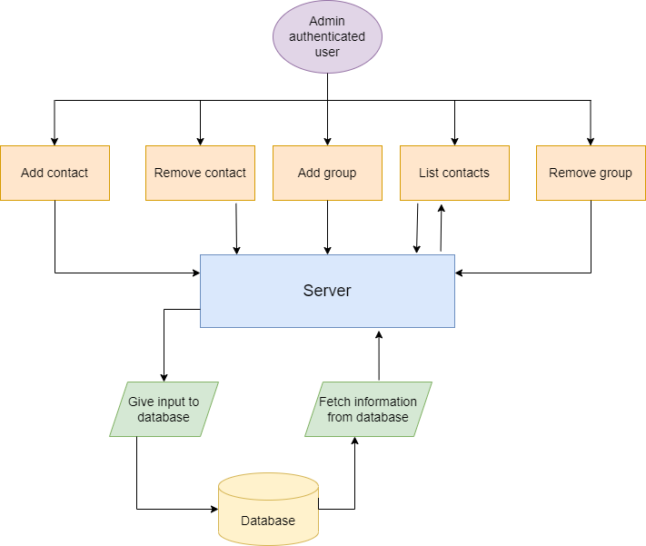
FLOWCHART FOR ADMIN & AUTHENTICATED USER

Slide 15
03
FUNCTIONS & CODE EXECUTION

Slide 16
USERS AND THEIR FUNCTIONALITIES
Functions User | ANONYMOUS | AUTHENTICATED | ADMIN
ADD GROUP | ❌ | ❌ | ✔
REMOVE GROUP | ❌ | ❌ | ✔
ADD CONTACT | ✔ | ✔ | ✔
REMOVE CONTACT | ❌ | ✔ | ✔
VIEW LIST | ❌ | ✔ | ✔
CHANGE GROUP | ❌ | ✔ | ❌

Slide 17
FUNCTIONS

Slide 18
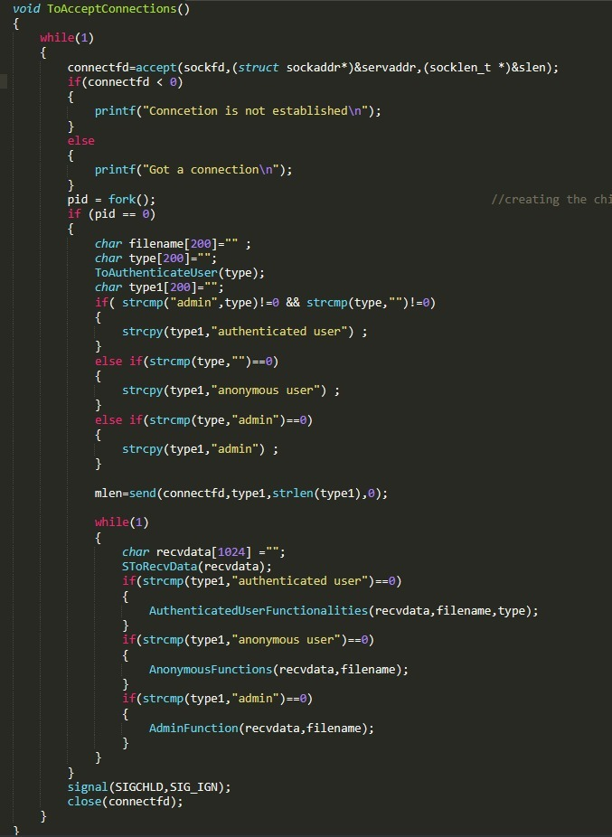
ACCEPT CONNECTIONS

Slide 19
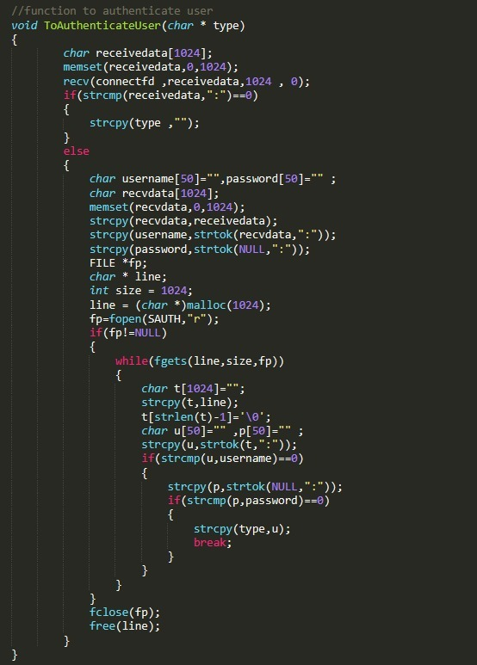
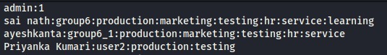
AUTHENTICATE USER

Slide 20
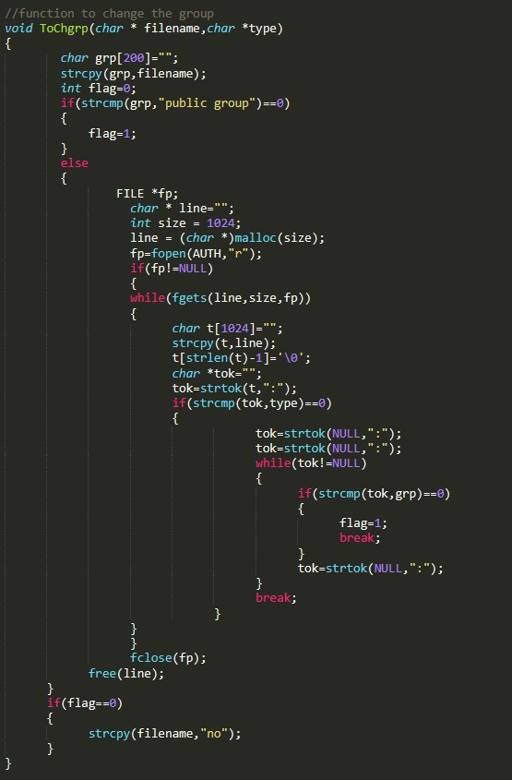
CHANGE GROUP

Slide 21
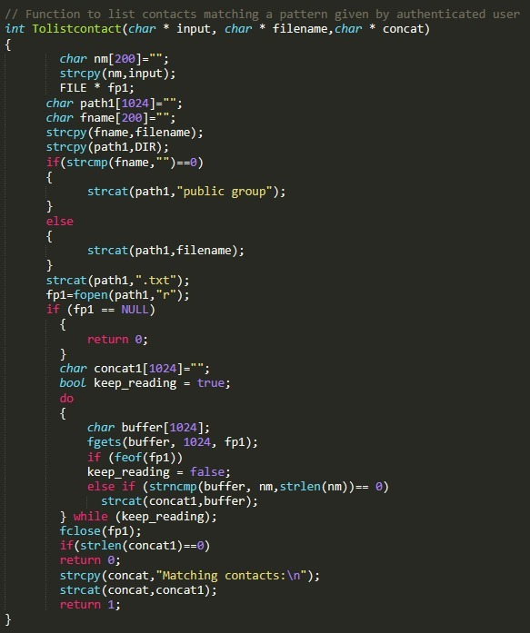
LIST CONTACT

Slide 22
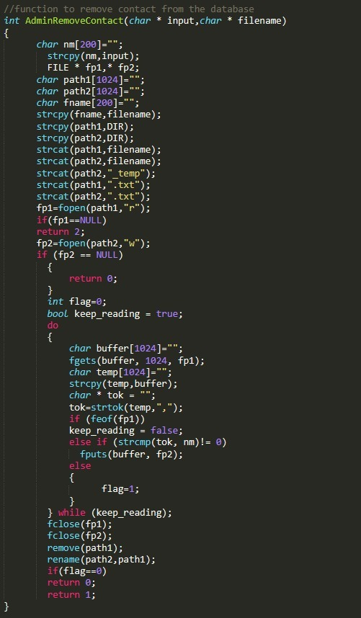
REMOVE CONTACT

Slide 23
CODE EXECUTION

Slide 24
04
NON-FUNCTIONAL REQUIREMENTS
(TOOLS & TESTING)

Slide 25
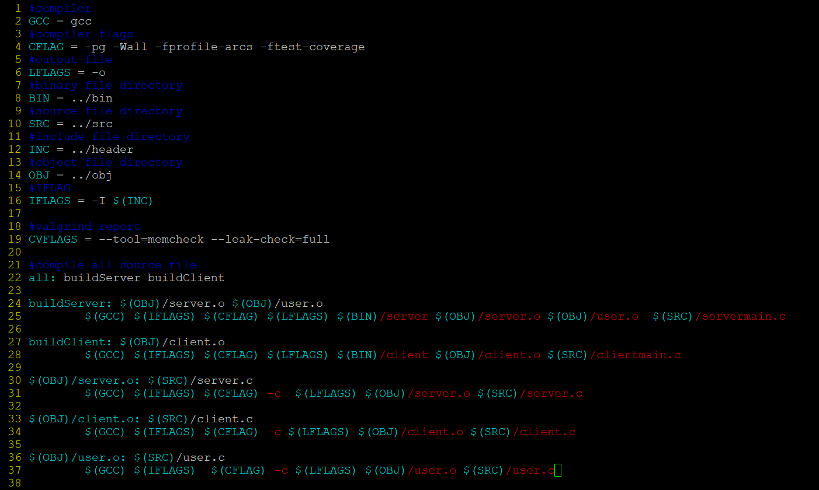
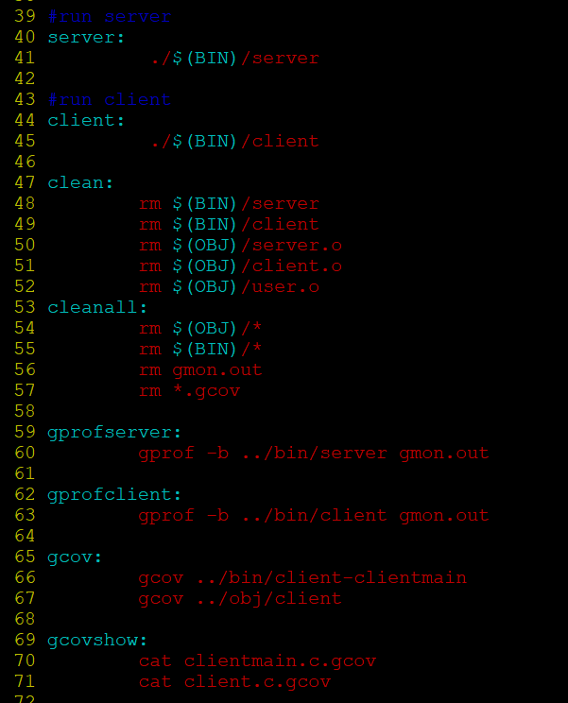
MAKEFILE
MAKEFILE: It is a way of automating software building procedure and other complex tasks with dependencies.

Slide 26
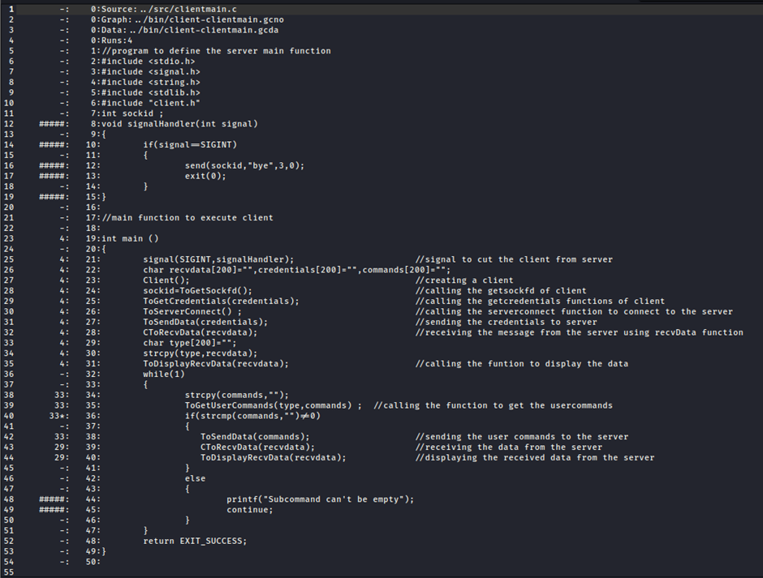
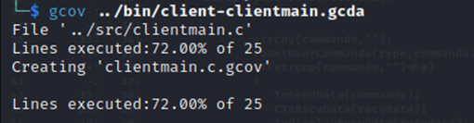
GCOV REPORT
GCOV: It is a source code coverage analysis and statement by statement profiling tool

Slide 27
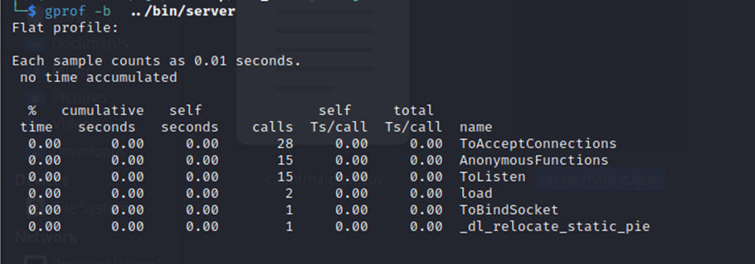
GPROF REPORT OF SERVER
GPROF: It is a profiling program which collects and arranges statistics on your program

Slide 28
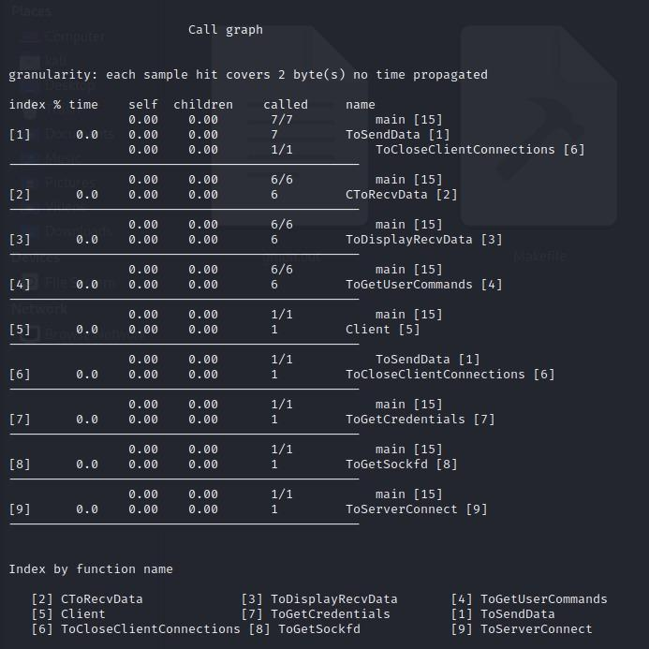
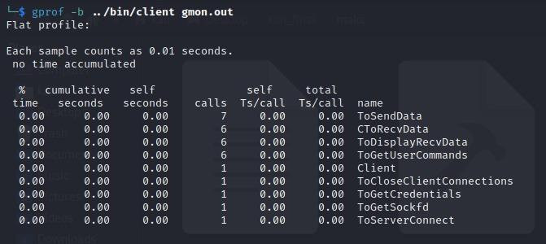
GPROF REPORT OF CLIENT

Slide 29
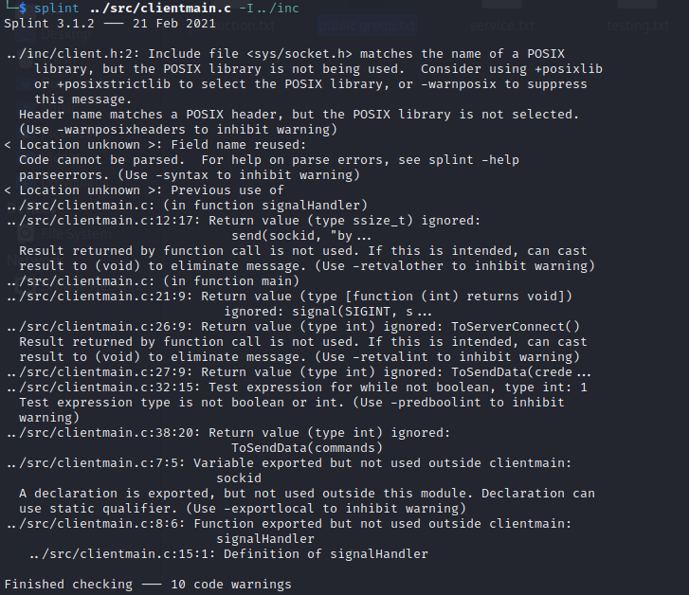
SPLINT REPORT
SPLINT: It is a programming tool for statistically checking c programs for security vulnerabilities and coding mistakes.

Slide 30
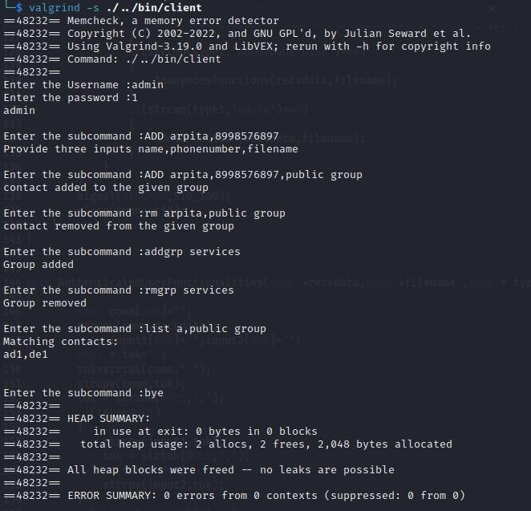
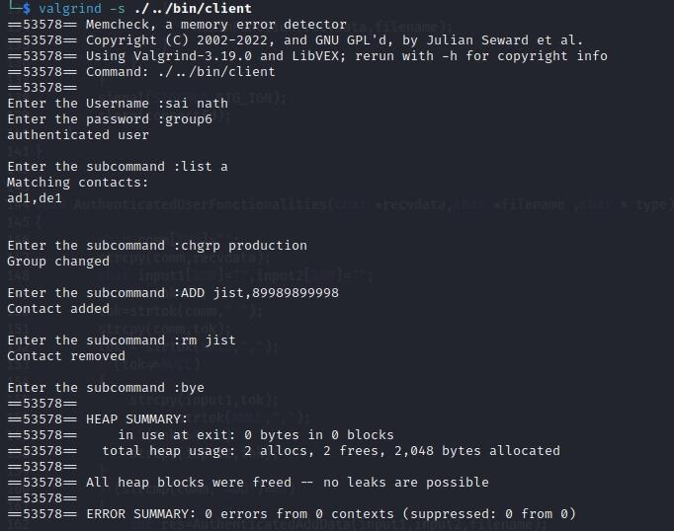
VALGRIND REPORT
VALGRIND: It is a tool for finding memory access errors to heap memory in c programs.

Slide 31
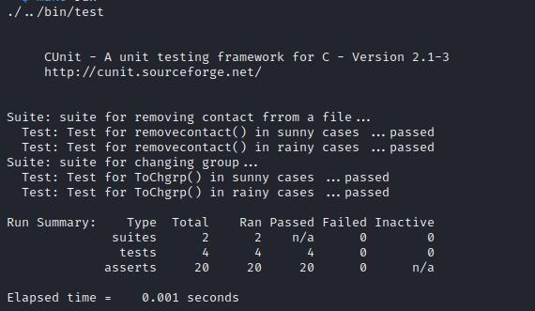
CUNIT TESTING
CUNIT: Itis a built as a static library which is linked with the users testing code.It uses a simple framework for building test structures ,and provides a rich set of assertions for testing common data types.

Slide 32
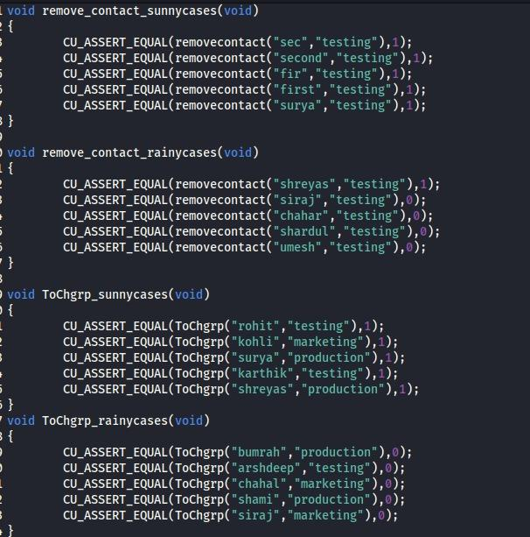
Asserts

Slide 33
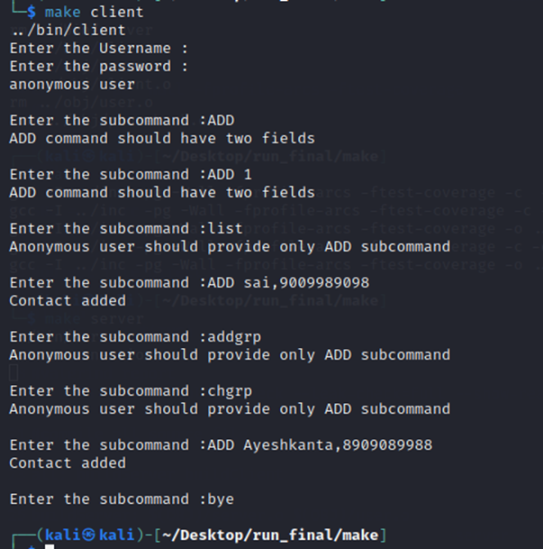
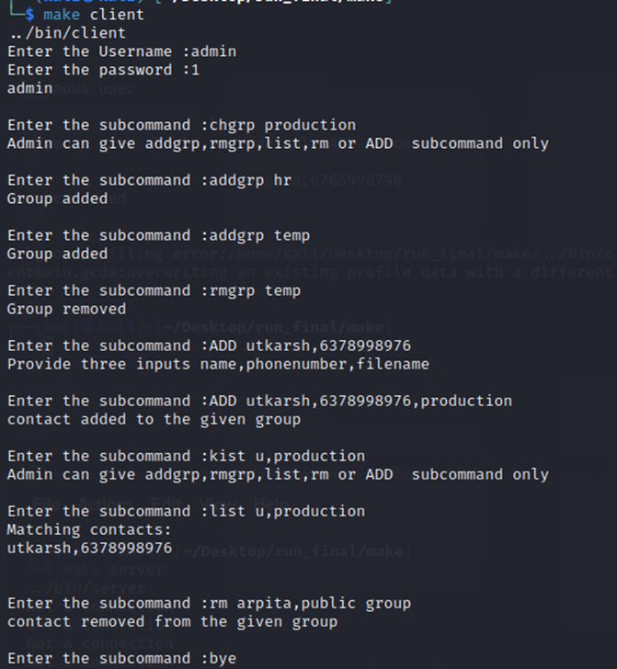
INTEGRATION TESTING

Slide 34
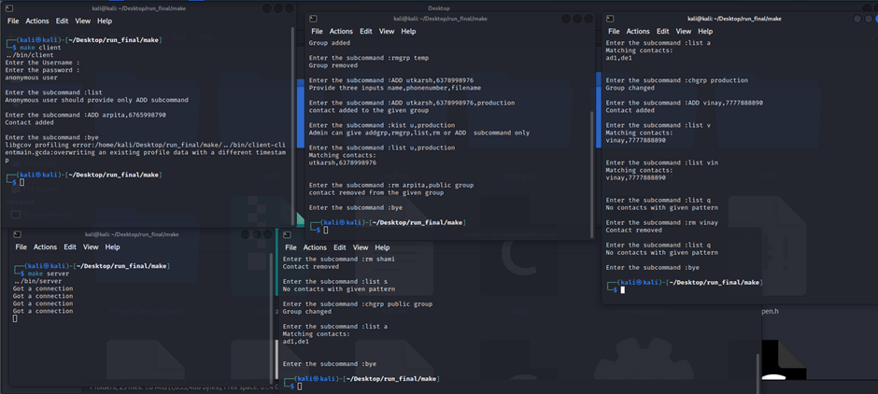
OUTPUT(HANDLING MULTIPLE CLIENTS)

Slide 35
05
APPLICATIONS AND CHALLENGES FACED

Slide 36
APPLICATIONS OF THE PROJECT
Remote phonebook has wide range of application in corporate world as it replaces the old method of keeping a record of phone numbers into digitally and remotely accessible phonebooks.
The ease of accessing the phone record for a user will be much easier.
With the help of creating group feature , phonebook can be customised for a group of user/users.
Admin can restrict access to groups and the phonebook itself. This feature comes very handy in a corporate workplace.

Slide 37
DEVELOPMENTS IN PROJECT CODE
We can make an advancement such that we can also add authenticated user details(username and password) during the code execution rather than hard coding
We can also update it such that we can work on binary files too.
Also we can give access to authenticated user for public group.

Slide 38
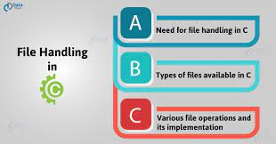

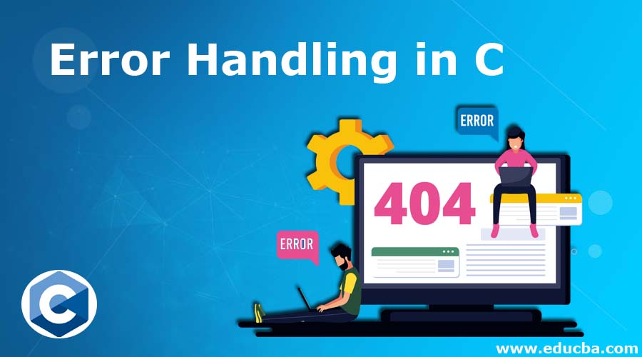
CHALLENGES FACED
First
Second
Third
File handling
String operations and returning string pointers
Error management

Slide 39
CONCLUSION
●Successfully completed the coding and testing phases as per the given problem statement.
●Got the expected results for the automated system with efficient and time saving methods.

Slide 40
GITHUB LINK
https://github.com/Ayesh18/Remote_Phonebook

Slide 41
THANK YOU

